Slide 1
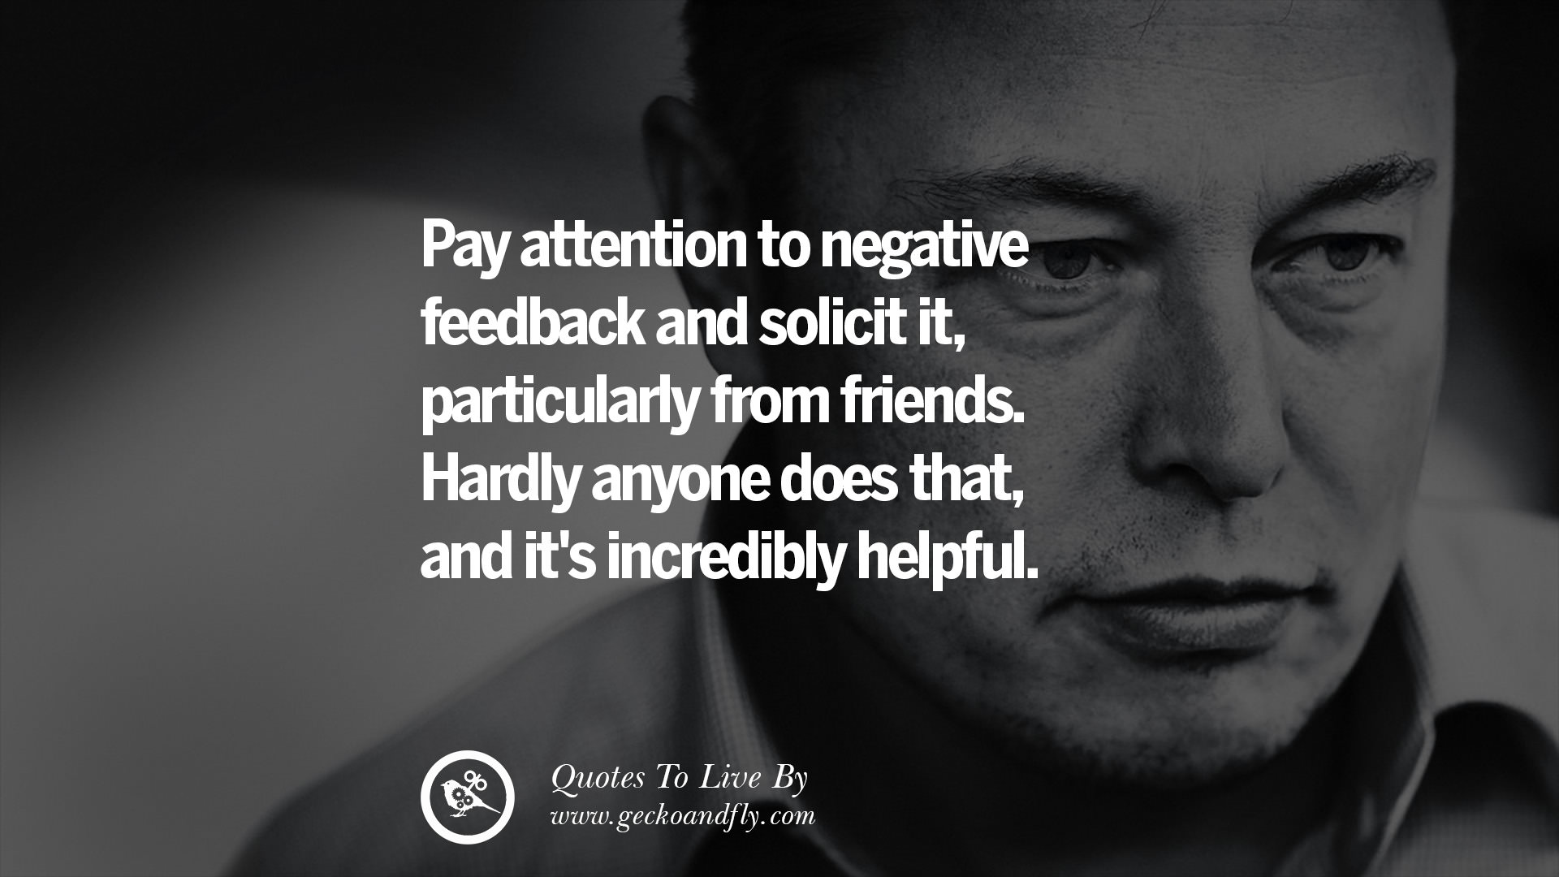

Slide 2
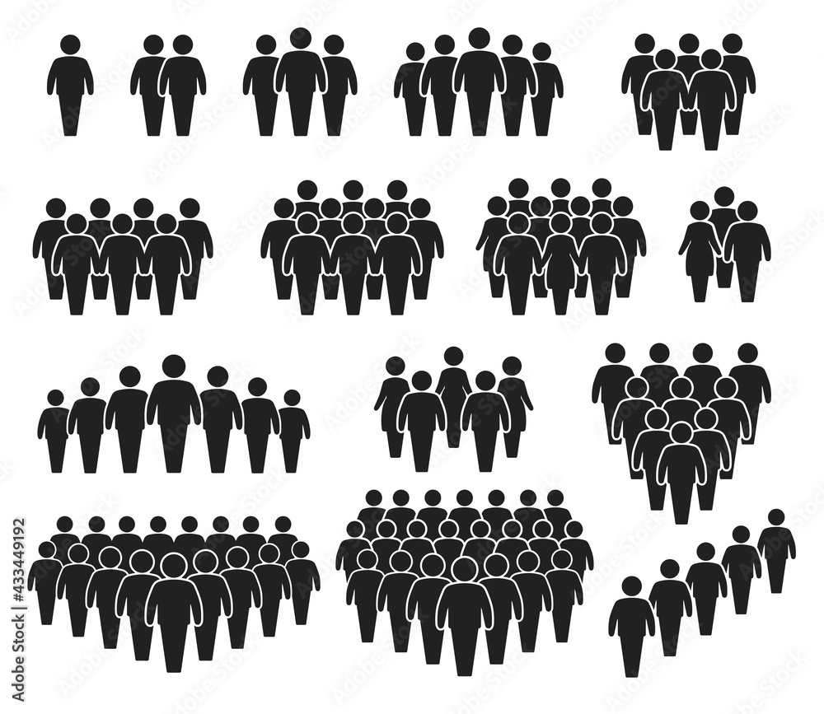
Customer Discovery

Slide 3


Slide 4
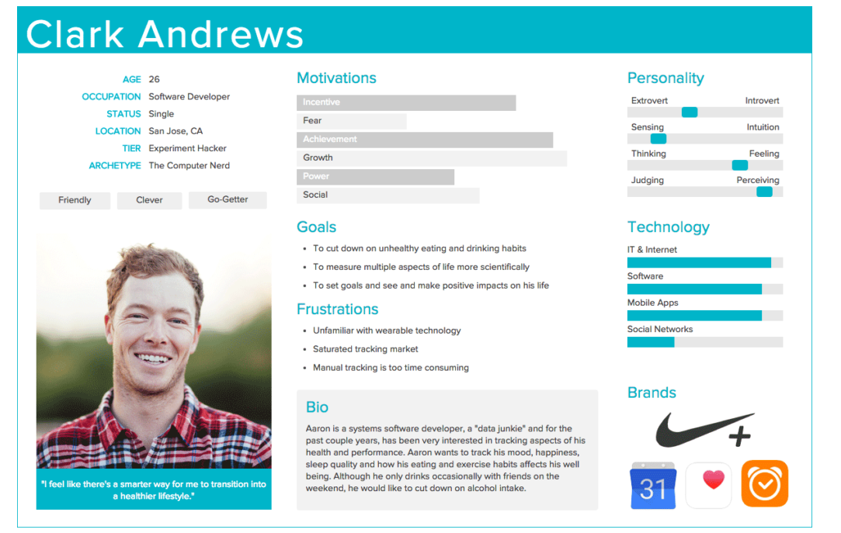

Slide 5

You just have to ask the right questions

Slide 6
Of the Early Adopters

Slide 7

Notes:
The year was 2007, and roommates Joe Gebbia and Brian Chesky couldn't afford their San Francisco rent. They actually worked on a roommate-matching service for four months until they realized Roommates.com was already a thing. Then they went back to working on Air Bed and Breakfast. Now worth $130b

Slide 8
Airbnb Early Adopters
Individuals willing to sleep on an air mattress in someone’s apartment.

Slide 9

America on Tech

Slide 10
America on Tech Early Adopters
Students from disadvantaged schools wanting tech training
Wall Street executives and firms willing to provide funding for AoT

Slide 11
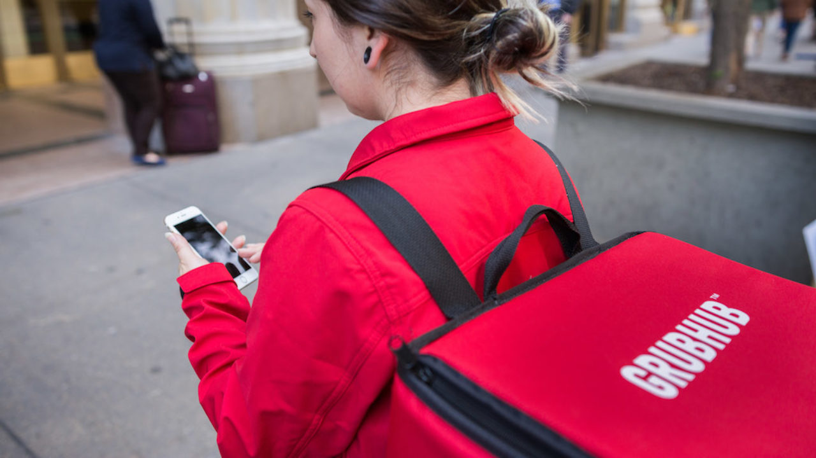
Notes:
In 2004 Matt Maloney and Mike Evans had to build a website of their own just to find out which restaurants in their area would deliver. Now worth $12b

Slide 12
GrubHub Early Adopters
Those interested in having food delivered during the busy lunch rush in New York City.

Slide 13

Grameen Bank

Slide 14
Grameen Bank Early Adopters
Women needing microloans to purchase supplies- bamboo, string, etc
Individuals willing to give their time and money to make and manage microlending

Slide 15
Pick your best idea.
Early adopters must be other students like the ones in this room!

Slide 16
Describe the Early Adopters.

Slide 17
Ask the potential early adopters about it.
Is it the problem you think it is?

Slide 18

Customer do not buy ideas they connect with their emotions.

Slide 19
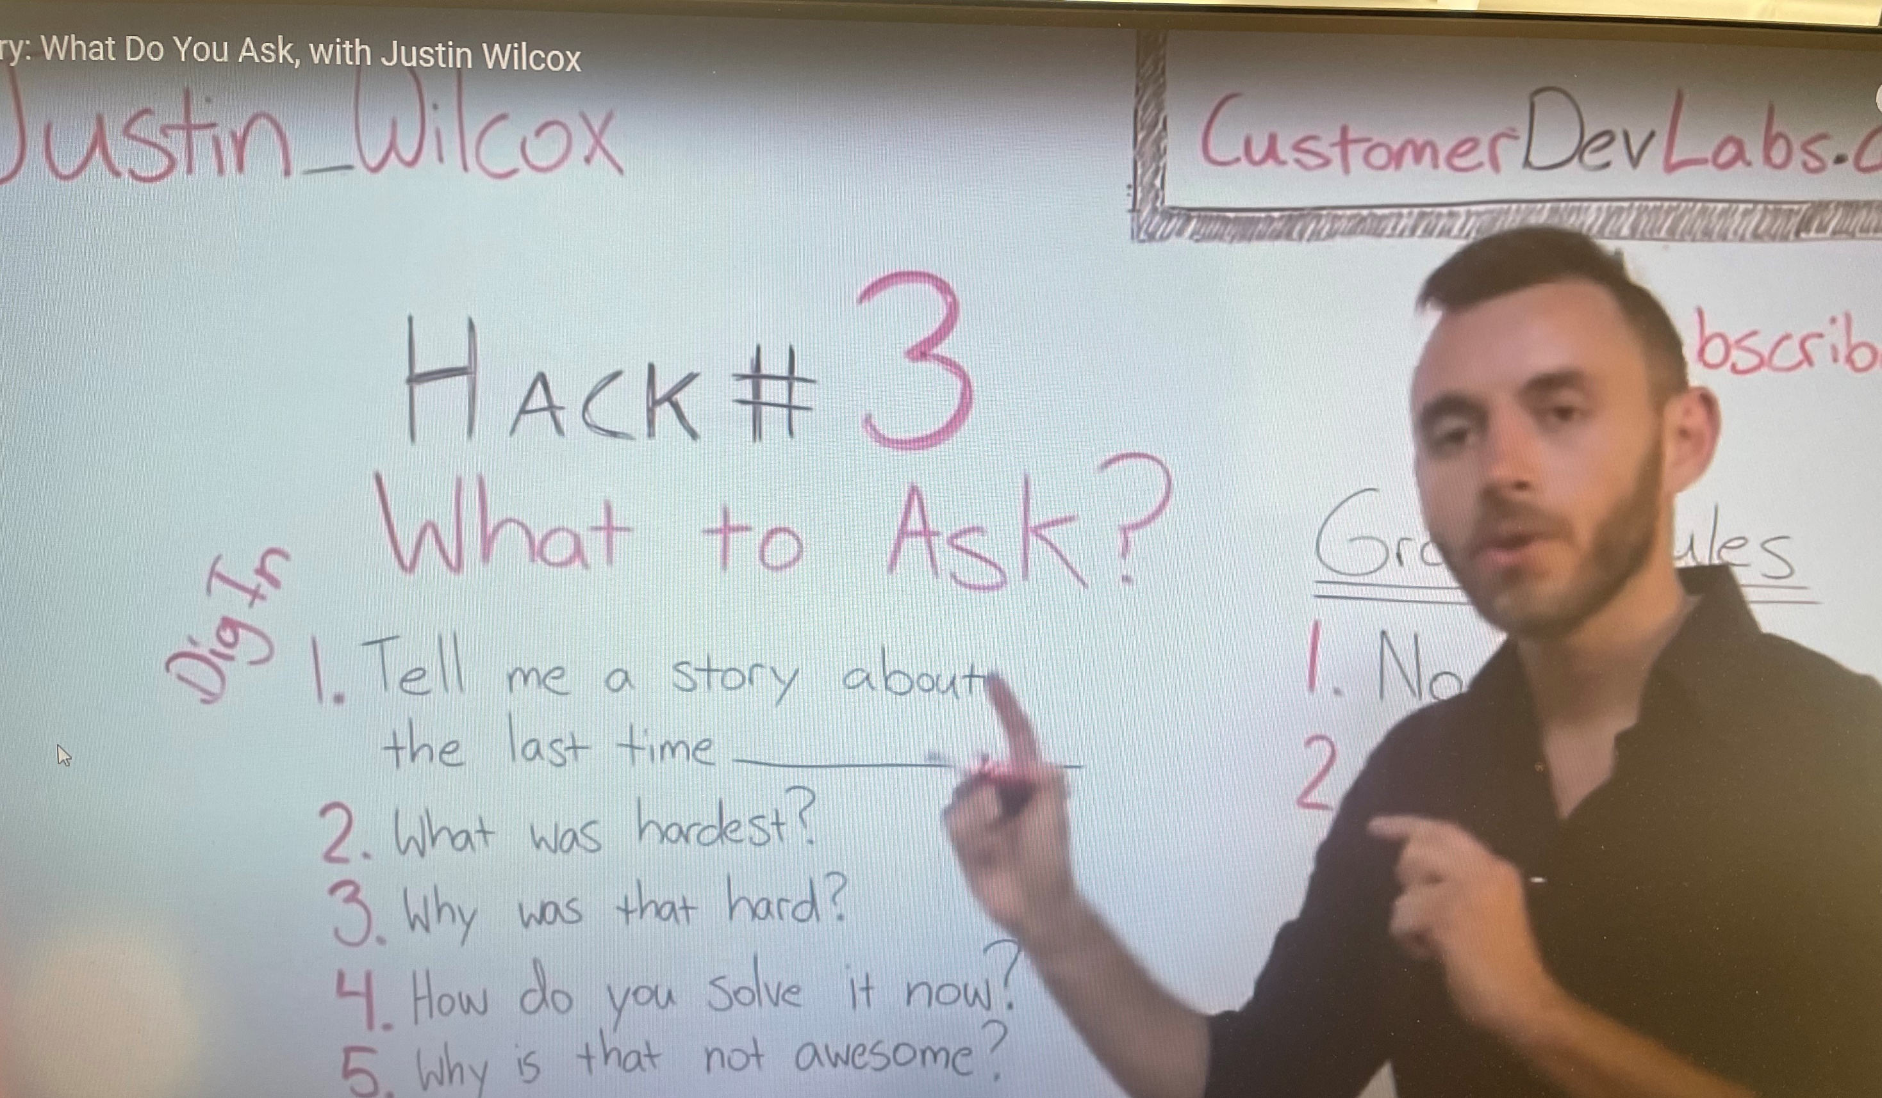

Slide 20
Interview Do’s
Ask Follow-up Questions. Use the power of “Why?”
Empathize. Make your interviewee feel more comfortable by normalizing their experience. Phrases like, “It makes sense that you’d feel ....” and
Take Notes. Take some notes about your customer’s problems, emotions, or phrases you don’t understand, so you can ask follow up questions.

Slide 21

Don’t Offer Solutions
Listen now, solve later

Slide 22
Questions
What Is the hardest part about being someone who is . . . a college student while studying, a golfer, running a party, getting an internship, driving an electric car, . . . .
Tell me about the last time you had this problem.
Did it make you feel angry? afraid? ashamed? bored? embarrassed? frustrated? scared? worried?
How did you solve this problem? What was not ideal about the solution?
Do you know of other people experiencing the same problem? (use only if the problem described is something you are interested In solving.)

Slide 23

Assignment
Develop a Customer Discovery script. What questions are you asking?
Find 10 individuals that are potential early adopters. This may require you to talk to more than 10 people.
Ask these 10 individuals your customer discovery questions. Record answers in your Idea Journal.

